Slide 1



COMPUTER
WORKSHOP
CSP-155
Experiment 7

Slide 2
Installation Of Widows/
Ubuntu And Updating Drivers

Slide 3
LESSON OBJECTIVE
To get insights into how to install OS into your system and how to update drivers for proper functioning of system.

Slide 4

LET’S BEGIN

Slide 5
Installing Windows
You can perform a clean installation of Windows 8.1 if you purchased Windows 8.1 on DVD or purchased a download of Windows 8.1.
A clean installation typically means formatting your hard drive before installing Windows, so make sure that you have backed up your files and created recovery disc by MSI BurnRecovery tool before proceeding.
To perform a clean installation using a DVD or USB flash drive.

Slide 6
Create Bootable USB
The Best Free Tools for Creating a Bootable Windows or Linux USB Drive
Rufus (for Windows)
Ubuntu Startup Disk Creator
Universal USB Installer
WiNToBootic
Windows Bootable Image (WBI) Creator
WinToFlash
XBoot

Slide 7
Installing Windows
If you bought Windows 8.1 on DVD or created a DVD or USB flash drive when you purchased and downloaded Windows 8.1, follow these steps to perform a clean installation.
Turn on your PC so that Windows starts normally, insert the Windows 8.1 DVD or USB flash drive, and then shut down your PC.
Restart your PC. Your laptop will boot from Windows 8.1 DVD or USB flash drive. Press any key when prompted by message “Press any key to boot from CD or DVD…”.

Slide 8
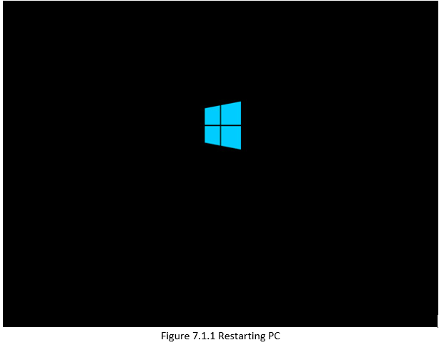
Installing Windows

Slide 9
Installing Windows
If you restart your PC and your current version of Windows starts, you might have to change the boot order in your PC's BIOS settings so that your PC boots from the media.
To change the boot order, you'll generally press Delete key immediately after you turn on your PC.
When you get into BIOS Setup Menu, please select Boot tab and set your media as the first boot order.

Slide 10
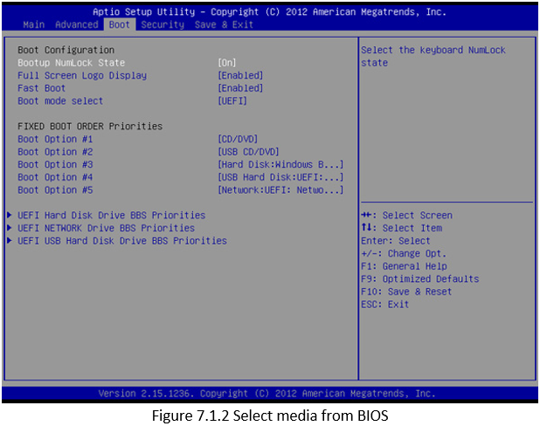
Installing Windows

Slide 11
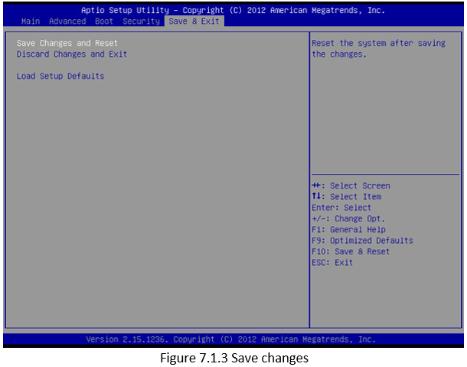
Installing Windows
Move to Save & Exit tab, select [Save Changes and Reset] and leave BIOS Setup Menu.

Slide 12
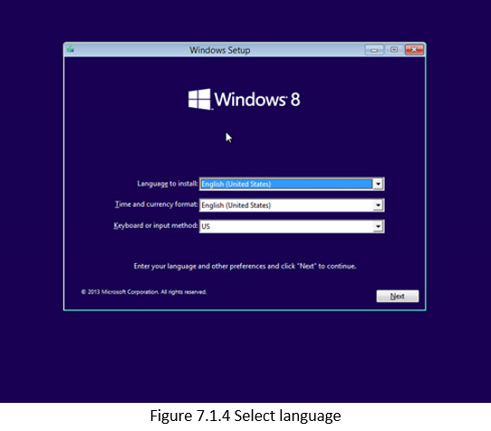
Installing Windows
Please setup language along with other preferences and click [Next].

Slide 13
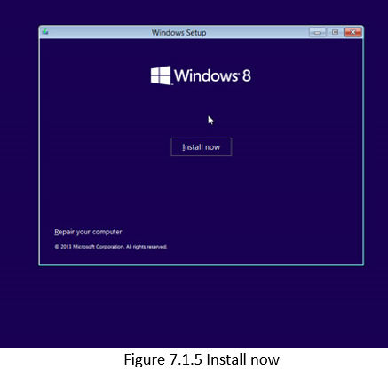
Installing Windows
Click [Install now] to start the process.

Slide 14
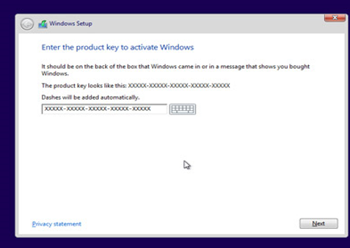
Installing Windows
Enter the product key to activate Windows 8.1 and click [Next]. (You should find the key in the disc package or in a message that shows you bought Windows. If not, please contact disc provider.)

Slide 15
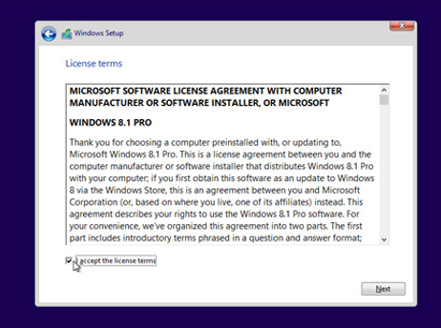
Installing Windows
Accept the license terms and click [Next].

Slide 16
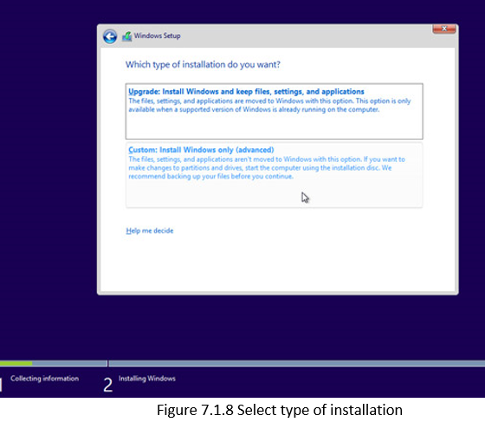
Installing Windows
Choose the installation type you want. MSI recommend [Custom: Install Windows only (advanced)].

Slide 17
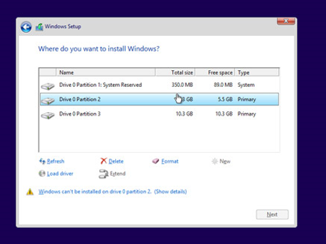
Installing Windows
Delete all existing partitions by selecting one partition at a time and then click [Delete] link.

Slide 18
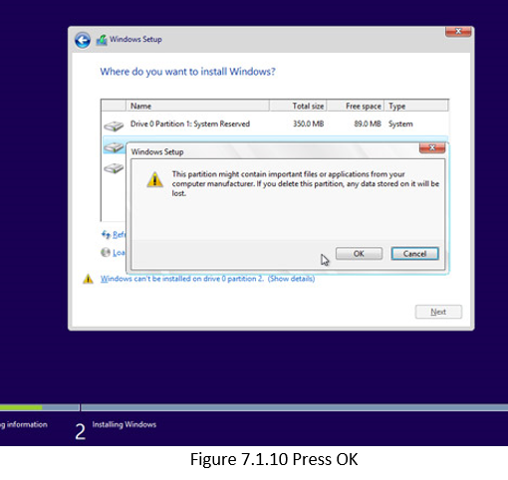
Installing Windows
Press [OK] when prompted by the message.

Slide 19
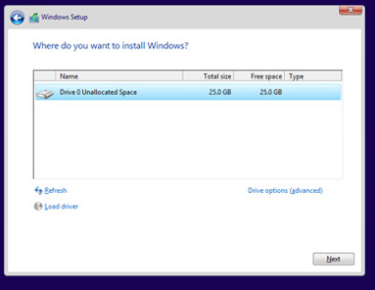
Installing Windows
All the space on the hard drive is now unallocated. Please create partitions by clicking [Drive options (advanced)].

Slide 20
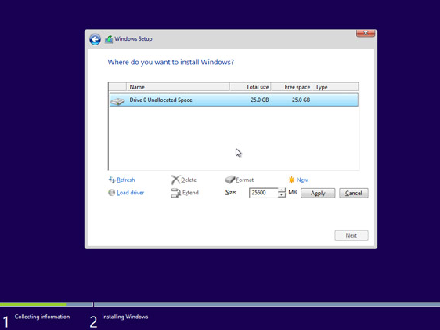
Installing Windows
11. Click [New] and decide a proper partition size for the partition.

Slide 21
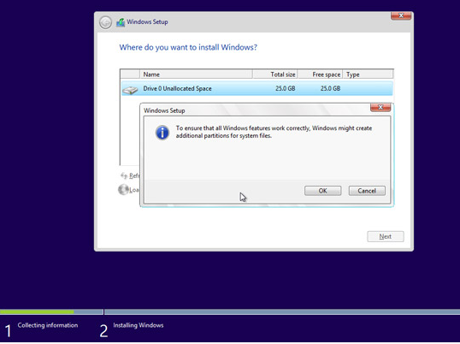
Installing Windows
12. Windows will create another partition to store system files in. Please press [OK]. Follow step 10 to create partitions for the rest of unallocated space if required.

Slide 22
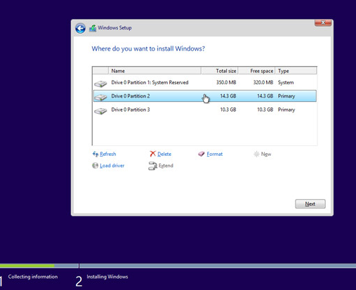
Installing Windows
13. Select one partition and click [Format] link to perform partition format.

Slide 23
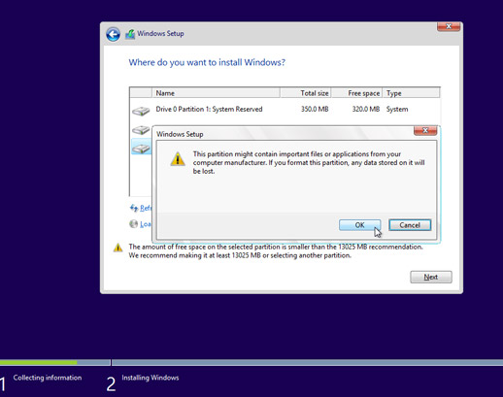
Installing Windows
14. You will be prompted to confirm the process. Press [OK]. Format other partitions as well except the one reserved for system files.

Slide 24
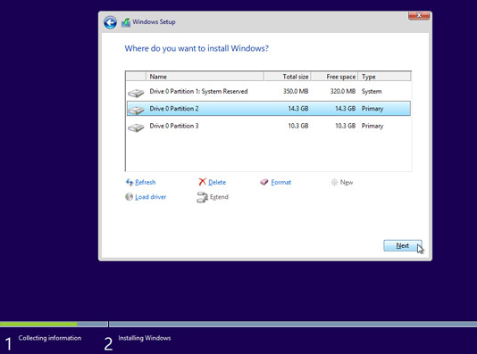
Installing Windows
15. Select the partition where you want to install Windows to and press [Next].

Slide 25
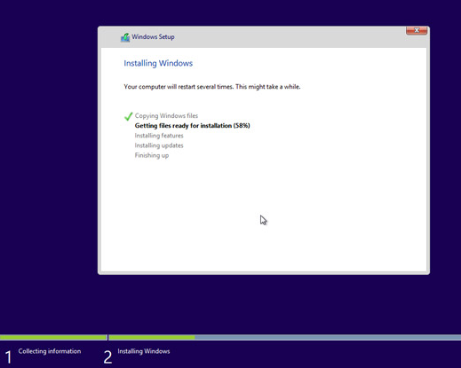
Installing Windows
16. Windows 8.1 is being installed and it will require several reboots during the process.

Slide 26
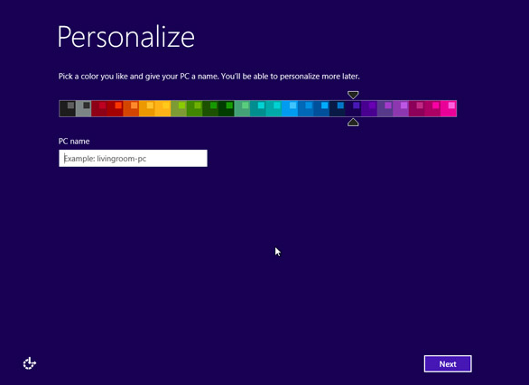
Installing Windows
17. Please follow onscreen instructions to personalize computer settings.

Slide 27
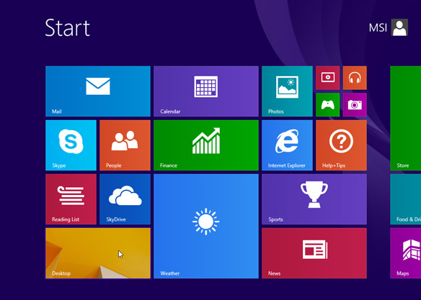
Installing Windows
18. Windows 8.1 is now installed successfully. Please perform Windows update and install the latest firmware/driver/app updates downloaded from MSI website.

Slide 28

Video on How to Install Windows 8
https://youtu.be/tzI8xh5XXnw Click below to watch the embedded video

Slide 29
New Ubuntu 20.04 Features
Linux Kernel 5.4 – This version of the Linux kernel adds support for a wider range of processors. It also includes improvements for boot speed, power-saving, and USB-C, plus several security features.
Gnome 3.36 – Gnome has been updated and improved. System animations should be smoother and have a lower impact on CPU usage.
ZFS 0.8.3 file system – Improved performance and native encryption.
Dark theme
Redesigned login screen
Newer versions of popular programming languages – Python 3.8, OpenJDK 11, PHP 7.4, Glibc 2.31, Rustc 1.41, GCC 9.3, Ruby 2.7.0, Perl 5.30, Golang 1.13.

Slide 30
Prerequisites
1. System requirements (recommended):
2 GHz dual-core processor
4GB memory
25GB available disk space for storage (less if installing the minimal version)
DVD drive or USB port
2. At least a 4GB USB drive

Slide 31
Step 1: Download the Installation Media
1. In a web browser, visit the Ubuntu download page and pick a version suitable for your machine. The most popular versions include:
Ubuntu Desktop
Ubuntu Server
Ubuntu Derivatives
https://ubuntu.com/download/desktop
2. Once you find the version you need, click the green Download button. You’ll be taken to a thank-you page, and your download should start. (We will download and install Ubuntu 20.04 for desktops.)

Slide 32
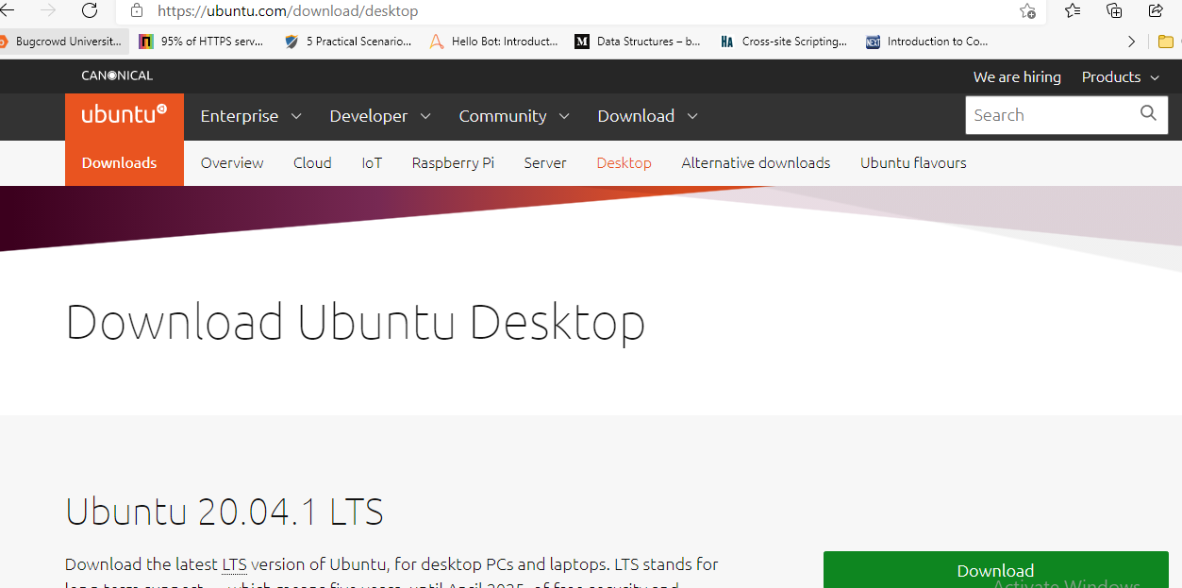

Slide 33
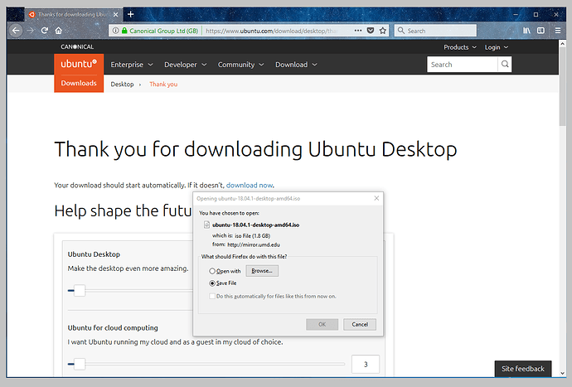
Take note of where your browser saves downloads: this is normally a directory called ‘Downloads’ on your Windows PC. Don’t download the ISO image directly to the USB stick! If using Windows XP or Vista, download version 2.18 of Rufus.

Slide 34

Step 1: Download the Installation Media
The download is an .iso file. You can use it to create a bootable USB drive.
3. Save the file to a location of your choice.
NOTE: If you’re installing to a virtual machine (like VirtualBox), you can mount the .iso image directly.

Slide 35
Step 2: Create Bootable USB
You will need a USB drive with 4GB or more. This process will delete all data on the USB drive. Make sure to backup any existing data on the USB drive.
Option 1: Create a Bootable USB Drive on Ubuntu
Use the Create startup disk tool:
Open a search dialog, and type create startup (for Ubuntu) /Rufus (for Windows).
If it’s not installed, the Software Centre will offer the option to install it – choose the option for USB drive, then open the utility.
In the top pane, click Other, then browse and select the Ubuntu 20.04 .iso file you downloaded.

Slide 36
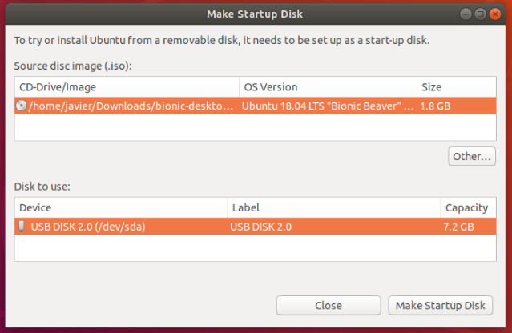
Step 2: Create Bootable USB on Ubuntu
In the bottom pane, select your USB drive.
Click Make startup disk.
Confirm USB.
This is important because any data currently stored on this device will be destroyed.

Slide 37
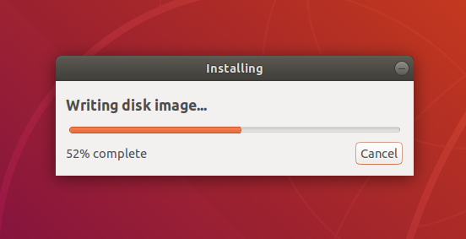
Step 2: Create Bootable USB on Ubuntu
After confirming, the write process will start and a progress bar appears.

Slide 38
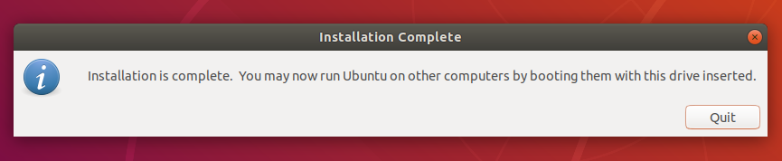
Step 2: Create Bootable USB on Ubuntu
That’s it! You now have Ubuntu on a USB stick, bootable and ready to go.

Slide 39
Step 2: Create Bootable USB on Windows
Option 2: Create Bootable USB Drive on Windows
You’ll need to install a third-party utility called Rufus to create a USB bootable drive.
Download the Rufus utility. Scroll down to the download section and click the link to download the latest version of Rufus.
2. Run the file once downloaded.

Slide 40
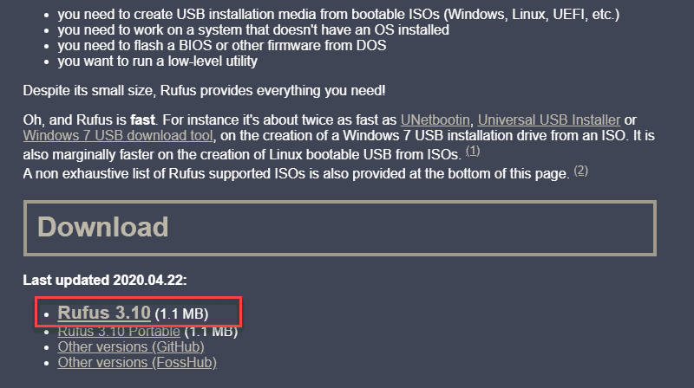
Step 2: Create Bootable USB on Windows

Slide 41
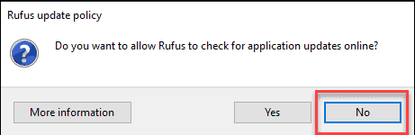
Step 2: Create Bootable USB on Windows
3. A pop-up dialog opens. You will be prompted whether you want to check for online updates. Select No.
4. The Rufus utility launches. Plug in the USB drive – you should see the drive pop up in the device field.

Slide 42
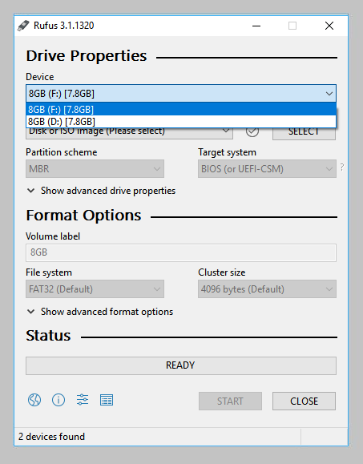
Step 2: Create Bootable USB on Windows
Set the USB as the device you wish to write to.
In the Boot Selection drop-down, click Disk or ISO Image.

Slide 43
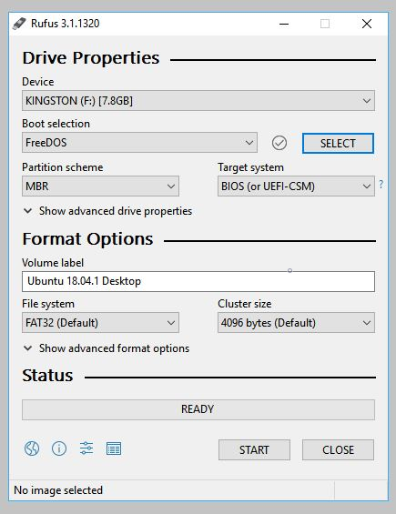
Step 2: Create Bootable USB on Windows
Now choose the Boot selection. Choices will be Non bootable and FreeDOS. Since you are creating a bootable Ubuntu device select FreeDOS.
The default selections for Partition scheme (MBR) and Target system (BIOS (or UEFI-CSM)) are appropriate (and are the only options available).

Slide 44
Step 2: Create Bootable USB on Windows
SELECT THE UBUNTU ISO FILE
To select the Ubuntu ISO file you downloaded previously, click the SELECT to the right of “Boot selection”. If this is the only ISO file present in the Downloads folder you will only see one file listed.
Select the appropriate ISO file and click on Open.

Slide 45
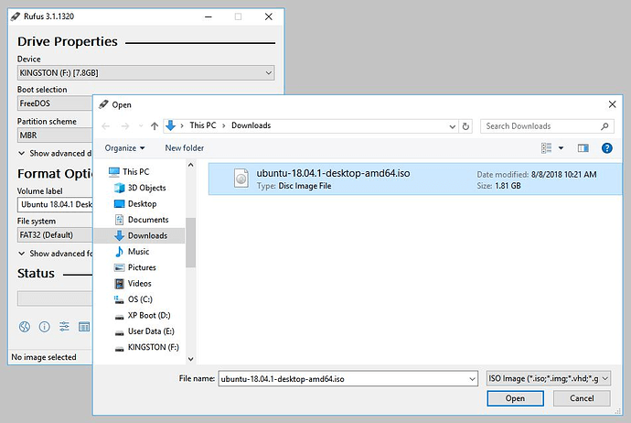

Slide 46
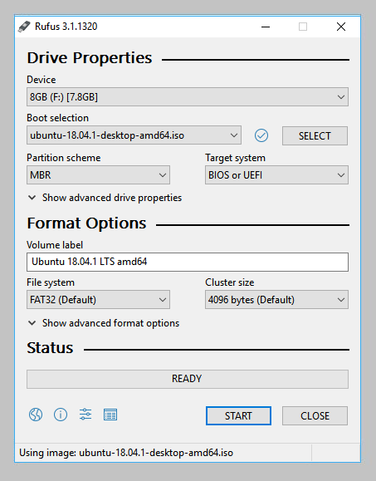
Step 2: Create Bootable USB on Windows
WRITE THE ISO
The Volume label will be updated to reflect the ISO selected.
Leave all other parameters with their default values and click START to initiate the write process.

Slide 47
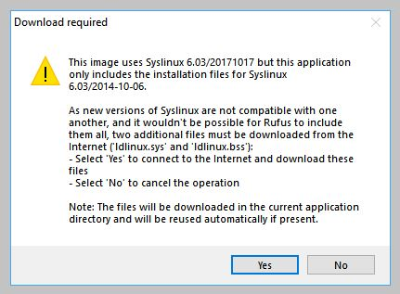
Step 2: Create Bootable USB on Windows
ADDITIONAL DOWNLOADS
You may be alerted that Rufus requires additional files to complete writing the ISO. If this dialog box appears, select Yes to continue.

Slide 48
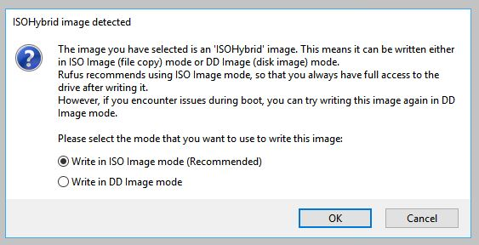
Step 2: Create Bootable USB on Windows
WRITE WARNINGS
You will then be alerted that Rufus has detected that the Ubuntu ISO is an ISOHybrid image.

Slide 49
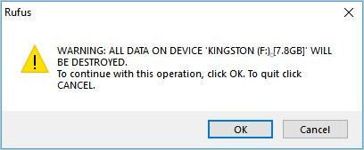
Step 2: Create Bootable USB on Windows
WRITE WARNINGS
This means the same image file can be used as the source for both a DVD and a USB stick without requiring conversion.
Keep Write in ISO Image mode selected and click on OK to continue.
Rufus will also warn you that all data on your selected USB device is about to be destroyed. This is a good moment to double check you’ve selected the correct device before clicking OK when you’re confident you have.

Slide 50
Step 2: Create Bootable USB on Windows
WRITING THE ISO
The ISO will now be written to your USB stick, and the progress bar in Rufus will give you some indication of where you are in the process.
With a reasonably modern machine, this should take around 10 minutes. Total elapsed time is shown in the lower right corner of the Rufus window.

Slide 51
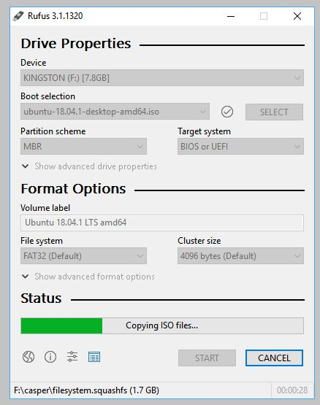
Step 2: Create Bootable USB on Windows
WRITING THE ISO
The ISO will now be written to your USB stick, and the progress bar in Rufus will give you some indication of where you are in the process.
With a reasonably modern machine, this should take around 10 minutes. Total elapsed time is shown in the lower right corner of the Rufus window.

Slide 52
Step 2: Create Bootable USB on Windows
INSTALLATION COMPLETE
When Rufus has finished writing the USB device, the Status bar will be green filled and the word READY will appear in the centre. Select CLOSE to complete the write process.

Slide 53
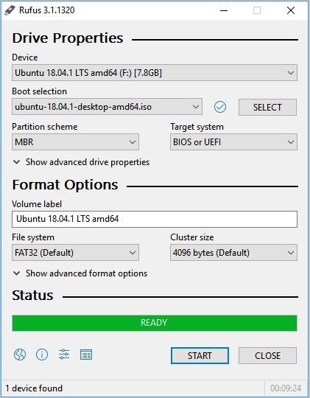
Step 2: Create Bootable USB on Windows
INSTALLATION COMPLETE
When Rufus has finished writing the USB device, the Status bar will be green filled and the word READY will appear in the centre. Select CLOSE to complete the write process.
INSTALLATION
COMPLETE

Slide 54
Step 3: Boot up Ubuntu from USB
To Create Bootable USB Drive on Apple MAC OS (Refer [3])
1. Turn off your system. Make sure you remove all other USB devices, such as printers, memory cards, etc.
2. Insert the Ubuntu USB drive into the system and turn on your machine.
There are two possible scenarios:
The computer boots the USB drive automatically.
You need to manually configure USB booting in the Boot Menu or BIOS/UEFI.

Slide 55
Step 3: Boot up Ubuntu from USB
3. To manually configure the boot order, tap the boot menu key about once or twice per second as soon as the computer powers on.
The boot menu key may be different depending on your computer manufacturer. Below is a list of common boot keys associated to a brand:
Asus F8 or Esc
Acer F12, F9 or Esc
Compaq F9 or Esc
Dell F12
eMachines F12
Fujitsu F12
HP F9 or Esc
Lenovo F8, F10 or F12
Samsung F2, F12 or Esc
Toshiba F12

Slide 56
Step 3: Boot up Ubuntu from USB
4. Once you see your boot menu, use the arrows to pick the Ubuntu media to boot from. For a DVD, the entry will usually have DVD or Optical in the name. USB is usually labeled USB.
Your system should start loading the Ubuntu live disc menu.
Note: If you are experiencing issues when booting the USB from the boot menu, try to boot the USB from BIOS/UEFI.

Slide 57
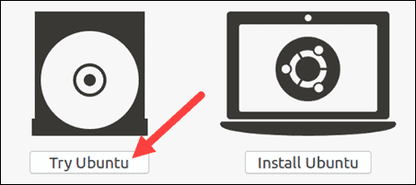
Step 4: Run Ubuntu
You can test Ubuntu 20.04 before you commit to installing it. The .iso includes a live mode that only runs in memory.
Launch this mode by clicking Try Ubuntu.

Slide 58
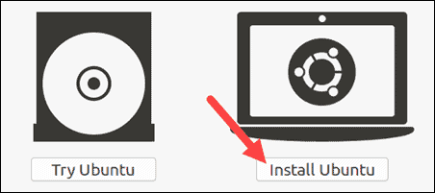
Step 5: Install Ubuntu 20.04 LTS Desktop
To begin the installation, click Install Ubuntu.
Choose Keyboard Layout
By default, the system will select English and English

Slide 59
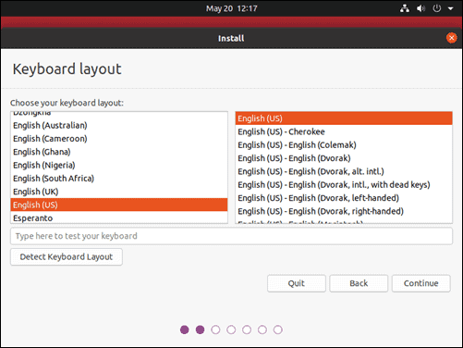
Step 5: Install Ubuntu 20.04 LTS Desktop
If you have a non-standard keyboard, you can select it in the list.
Alternately, click Detect Keyboard Layout and the system will automatically choose your keyboard.
If you need to test your keyboard, use the labelled field.
When you’re ready, click Continue.

Slide 60
Step 5: Install Ubuntu 20.04 LTS Desktop
CHOOSE STARTING APPLICATIONS
Normal Installation – This is the full Ubuntu Desktop experience, with office software, games, and media players.
Minimal Installation – Choose this to save disk space, especially if you won’t be using media players or productivity software.
You’ll also be asked to confirm other options:
Download updates while installing Ubuntu – This does the work of downloading large package files during the installation. Once the installation finishes, the packages will be ready to apply as updates.

Slide 61
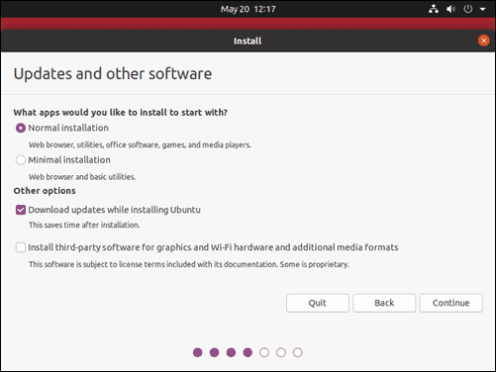
Step 5: Install Ubuntu 20.04 LTS Desktop
Install third-party software for graphics and Wi-Fi hardware and additional media formats –
Some hardware, like graphics cards and wi-fi cards, do not have open-source driver support.
Also, some media formats, such as .wmv, do not fall under the GPL license.
If you need support for these, you’ll need to agree to additional terms of use.

Slide 62
Step 5: Install Ubuntu 20.04 LTS Desktop
Install third-party software for graphics and Wi-Fi hardware and additional media formats –
Some hardware, like graphics cards and wi-fi cards, do not have open-source driver support.
Also, some media formats, such as .wmv, do not fall under the GPL license.
If you need support for these, you’ll need to agree to additional terms of use.

Slide 63
Disk Partitioning
Next, you’ll be presented with an Installation Type dialog.
You can wipe the hard drive clean prior to installing Ubuntu by clicking Erase disk and install Ubuntu.
If you go this route, skip ahead to the next step.
Advanced users may want to edit Advanced Features.
Use this to specify your own disk partitions or set other advanced options:
Use LVM with the new Ubuntu installation: LVM stands for Logical Volume Management.
This is a tool for dynamically managing different virtual drives on your system. It’s much like an enhanced version of the gparted tool.

Slide 64
Disk Partitioning
Encrypt the new Ubuntu installation for security: This will encrypt the drive’s contents. You’ll choose a security key, which will be required to decrypt and use the drive.
Experimental: Erase disk and use ZFS: ZFS refers to Zettabyte File System, but it has grown into a hybrid file system and volume manager. Since it’s still being tested, avoid this setting on mission critical production systems.
If you’d rather create your own hard drive partitions, click Something Else.
The next screen will allow you to create your own partition table and logical drives. This lets you divide a physical hard drive into different partitions. The operating system sees partitions as individual drives.

Slide 65
Disk Partitioning
Note: Some users create their /home directory on a separate partition. If the operating system needs to be reinstalled, the partition with the /home directory is unaffected.
Click Continue to apply your changes to the drive partitions.
You’ll be asked to Write changes to disks? None of the options you’ve selected are permanent until you click Continue on this screen. Click Continue to proceed.

Slide 66
Select Time Zone
Once the system formats the disk partitions, the installer will ask Where are you?
Type the nearest large city into the box, and the system will set your local time zone.
Click Continue.
Note: It's always possible to change the time-zone on Ubuntu at a later point in time.

Slide 67
Create User Account
Next, you’ll need to configure a user account. Fill in the following fields:
Name: Your actual name.
Computer name: This is the hostname or network name.
Username: The user account name you want to use.
Password: Enter and confirm a strong password – the installer will automatically evaluate your password strength.
Log in automatically: This is not recommended for publicly accessible servers.
Require my password to log in: This is recommended for publicly accessible servers.

Slide 68
Create User Account
Click Continue to install Ubuntu.
Once the installer finishes, remove the Ubuntu installation media. You’ll be prompted to Restart Now.

Slide 69
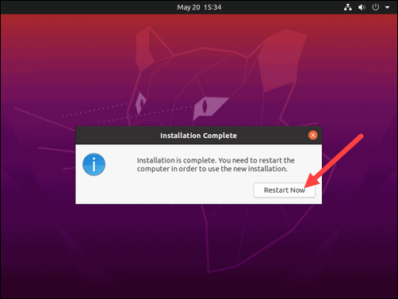
Create User Account
Click Continue to install Ubuntu.
Once the installer finishes, remove the Ubuntu installation media. You’ll be prompted to Restart Now.

Slide 70
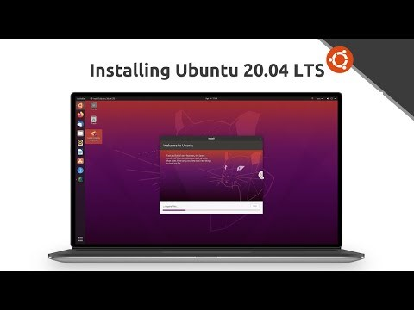
Video on How to Install UBUNTU 20.04 LTS
https://youtu.be/woXkRPiWLvc Click below to watch the embedded video

Slide 71
Windows Drivers
Windows comes with drivers for many devices, such as printers, displays, keyboards, and TVs.
A driver is software that a device uses to work with your PC.
Every device needs a driver to work with your PC. So, in many cases, you can plug in a device, and it’ll work automatically.
Windows can also download device software and info. This might include an app that the device manufacturer created to go with your device or info like the product name, manufacturer, and model number, to help you distinguish between similar devices.

Slide 72
Updating Drivers Automatically
Drivers are updated occasionally.
Windows can update them automatically, or you can install the updated drivers yourself.
It's important for you to have confidence in the updated drivers you install.
Windows notifies you if it detects a suspicious or unsafe driver you shouldn't install.
Windows 10 comes with a Driver Tool Kit that allows Windows to install latest driver whenever you attach new piece of hardware with your PC.
Also, you an download paid or free software online to update al drivers at once.

Slide 73
Updating Drivers Automatically
Swipe in from the right edge of the screen, tap Settings, and then tap Change PC settings. (If you're using a mouse, point to the lower-right corner of the screen, move the mouse pointer up, click Settings, and then click Change PC settings.)
Tap or click Update and recovery, and then tap or click Windows Update.
Tap or click Choose how updates get installed.
Under Important updates, choose Install updates automatically (recommended).

Slide 74
Updating Drivers Manually
To manually update driver in Windows 8 and Windows 8.1, follow these steps:
1. Swipe in from the right edge of the screen, and then tap Search.
2. Enter Device Manager in the search box, and click Device Manager.
3. In Device Manager window, expand categories and locate the device that you wish to update the driver for. Then right-click on the device name and select Update Driver Software.

Slide 75
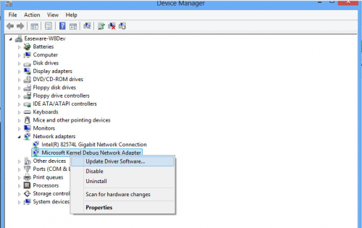
Updating Drivers Manually
Following screenshot is for your reference.

Slide 76
Updating Drivers Manually
Note: For some devices, the device name displayed in Driver Easy is different from the device name displayed in Device Manager.
In Driver Easy, you can click on the driver and get the name of current driver. Then locate the device in Device Manager using this name.
4. Click Browse my Computer for driver software.

Slide 77
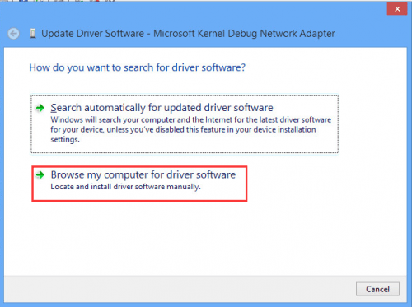
Updating Drivers Manually

Slide 78
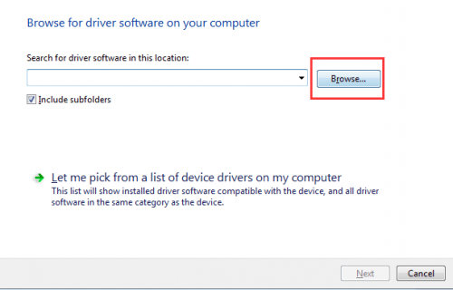
Updating Drivers Manually
5. Click Browse to find the location of the downloaded driver file. Then click Next button to install the driver.

Slide 79
Updating Drivers Manually
Click on below embedded video to watch the process.
https://youtu.be/ZvSRrVVhqV4

Slide 80
REFERENCES :
https://ubuntu.com/tutorials/create-a-usb-stick-on-ubuntu#1-overview
https://ubuntu.com/tutorials/create-a-usb-stick-on-windows#3-usb-selection
https://ubuntu.com/tutorials/create-a-usb-stick-on-macos#1-overview
https://phoenixnap.com/kb/install-ubuntu-20-04

Slide 81


